Slide 1
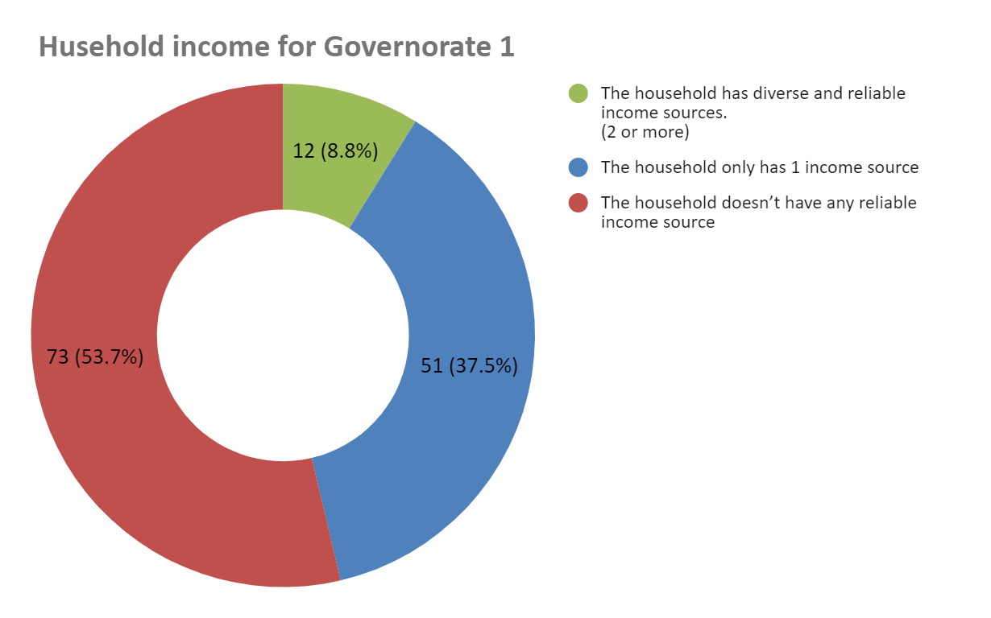
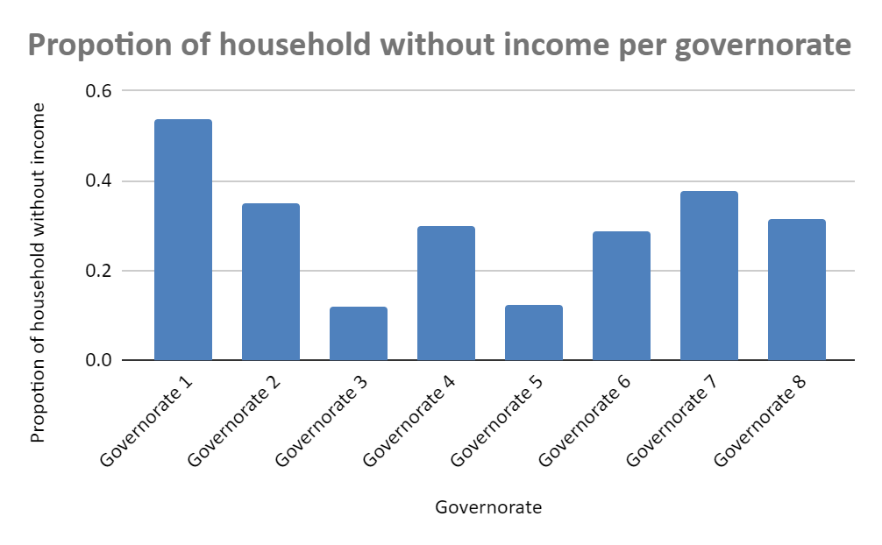
Findings and recommendations.
Findings
Majority of the household doesn’t have any reliable income source.
Governorate 1 has the highest proportion of people without single source of income.
Recommendations.
To reach out to those households with the least income, this program should focus more on areas where there is a high proportion of people without a single source of income starting with Governorate 1.

